Slide 1
Basics of
Machine Learning
Dmitry Ryabokon, github.com/dryabokon

Slide 2


Lesson 04
Data Visualization

Slide 3
Data Visualization
Summary
Colormaps
Squarify
Pairplot
Density
https://s3.amazonaws.com/assets.datacamp.com/blog_assets/Python_Seaborn_Cheat_Sheet.pdf

Slide 4
Data Visualization
Tutorials
ex_04a_colormaps.py
ex_04b_charts_squarify.py
ex_04c_charts_pairplot.py
ex_04d_charts_density.py

Slide 5
Colormaps

Slide 6



Data charts
Colormaps

Slide 7



Data charts
Colormaps

Slide 8



Data charts
Colormaps

Slide 9
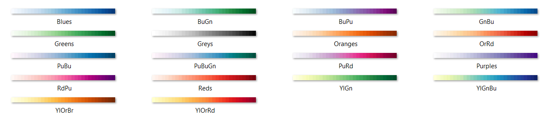
Data charts
Colormaps
http://holoviews.org/user_guide/Colormaps.html

Slide 10

Data charts
Colormaps

Slide 11
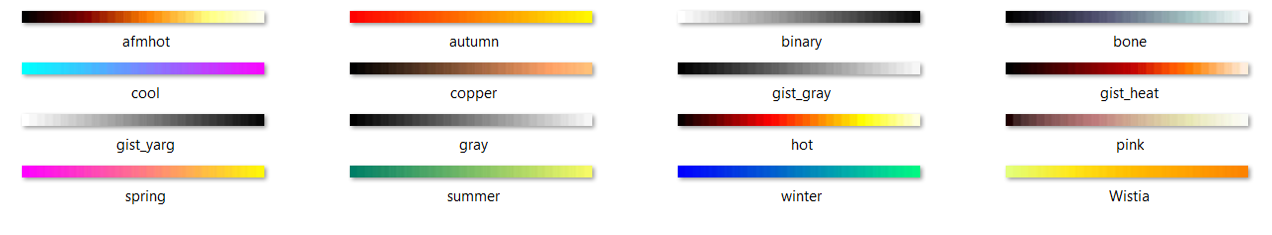
Data charts
Colormaps

Slide 12
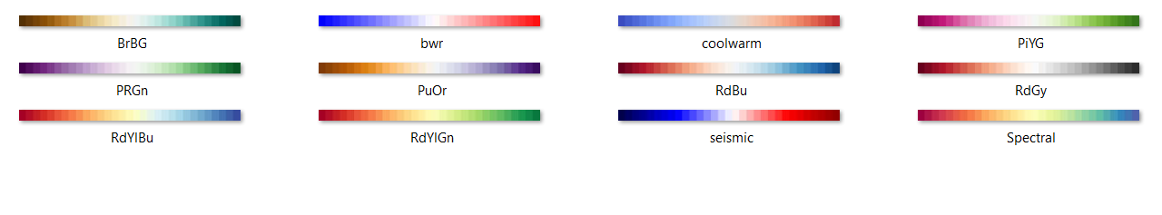
Data charts
Colormaps

Slide 13
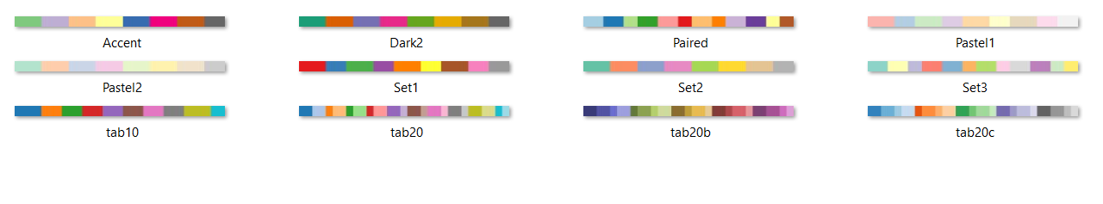
Data charts
Colormaps

Slide 14
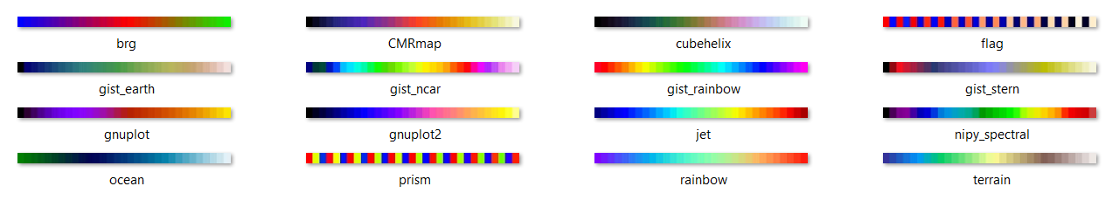
Data charts
Colormaps

Slide 15
Squarify

Slide 16
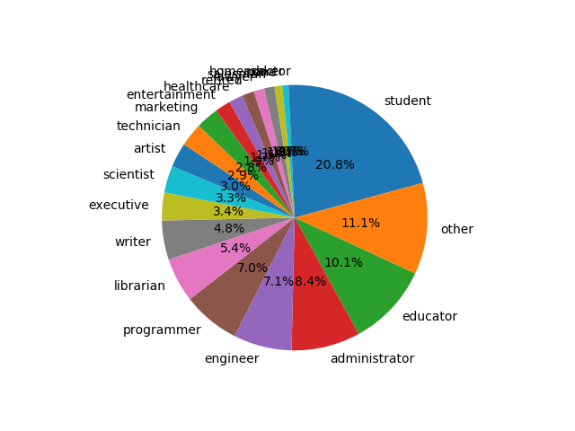
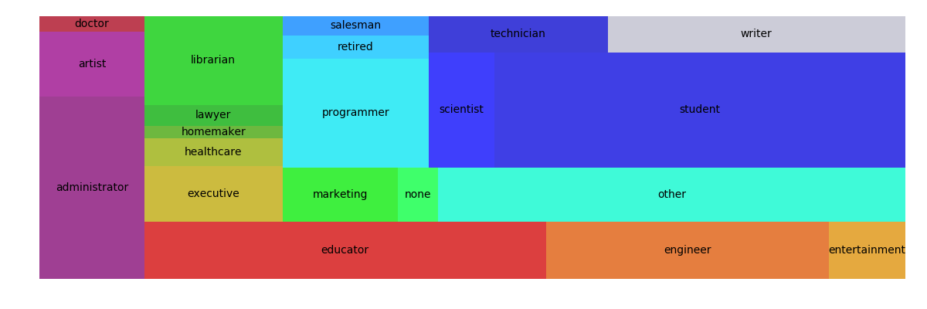
Data charts
Squarify: example 01

Slide 17
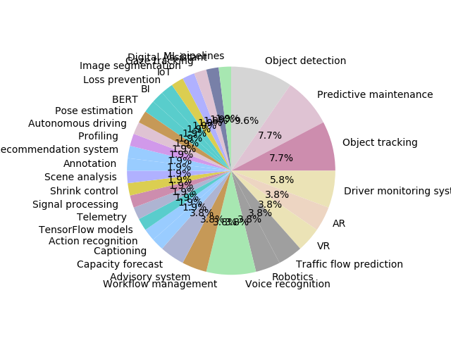
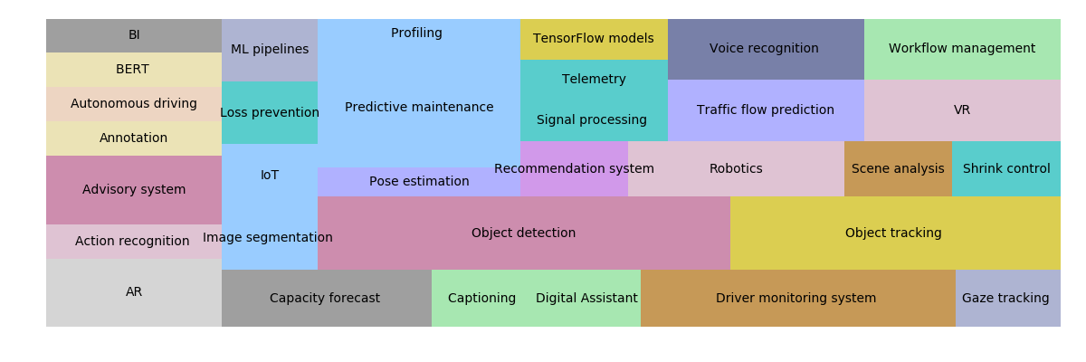
Data charts
Squarify: example 02

Slide 18
Pairplot

Slide 19
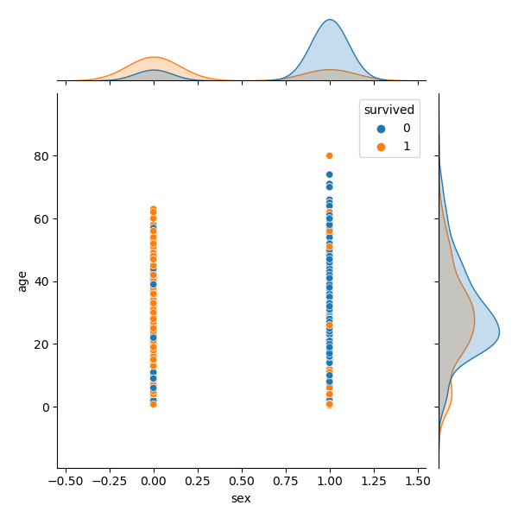
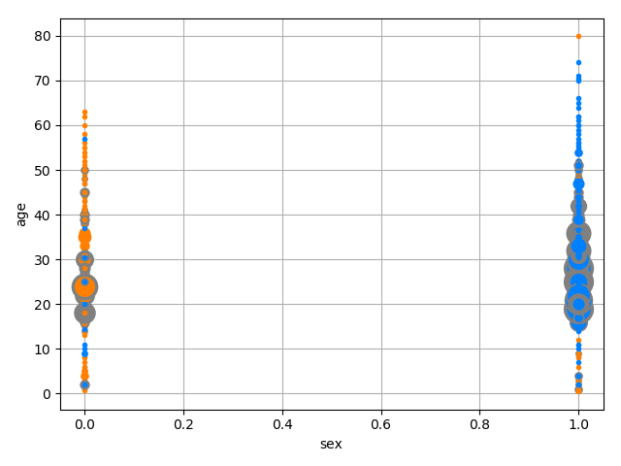
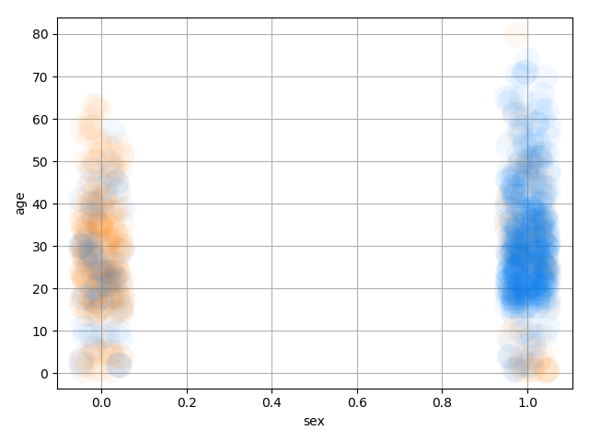
Data charts
Pairplot: titanic dataset

Slide 20
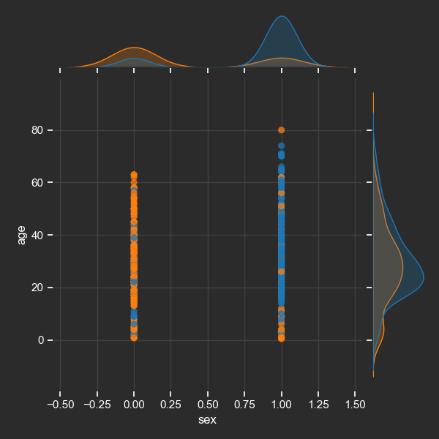
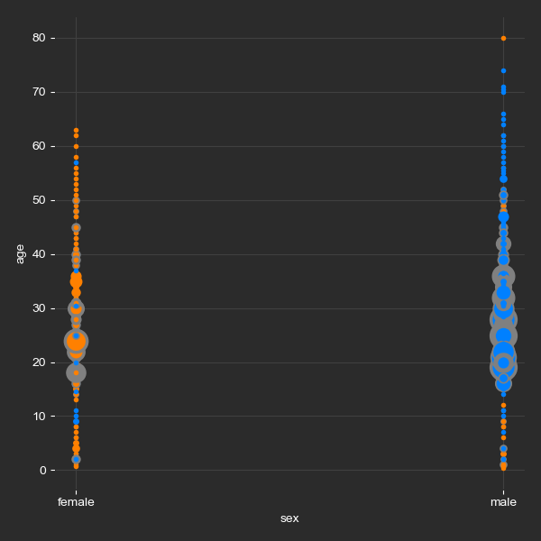
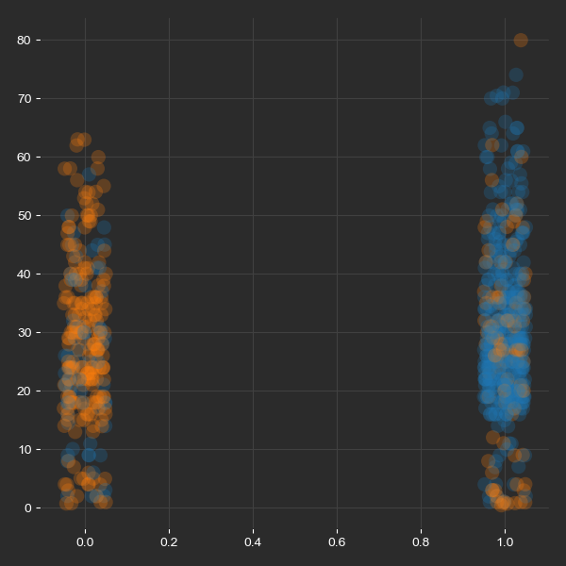
Data charts
Pairplot: titanic dataset: no imputing

Slide 21
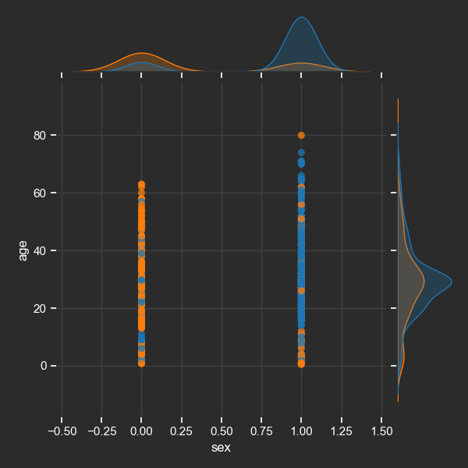
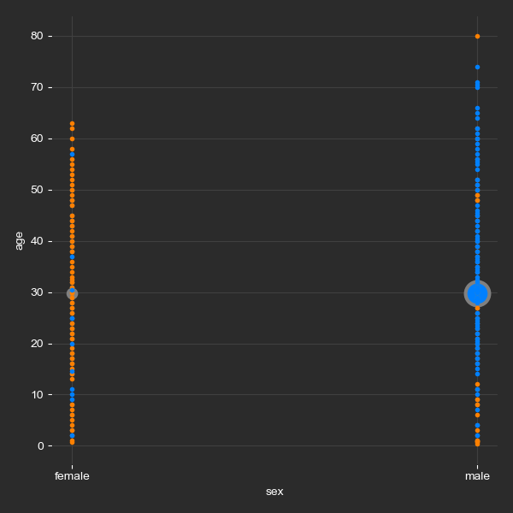
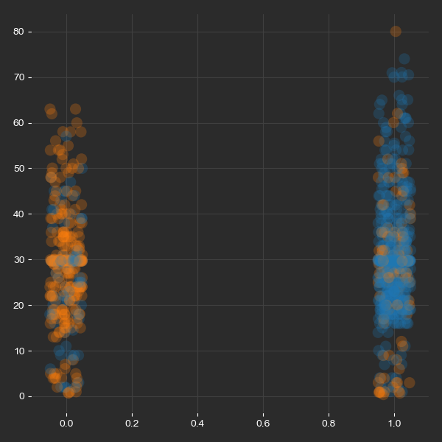
Data charts
Pairplot: titanic dataset: with imputing

Slide 22
Data charts
Pairplot: titanic dataset
columns = df0.columns.to_numpy() target = columns[idx_target] idx = numpy.delete(numpy.arange(0, len(columns)), idx_target) pal = numpy.array(['tab10', 'husl', 'Set2', 'Paired', 'hls'])[0]
for i in range(len(idx)-1): for j in range(i+1,len(idx)): c1, c2 = columns[idx[i]], columns[idx[j]] df = df0[[target, c1, c2]] df = df.dropna() df = tools_DF.hash_categoricals(df) fig = plt.figure() self.turn_light_mode(fig) J = seaborn.jointplot(data=df, x=c1, y=c2, hue=target,palette=pal,edgecolor=None)

Slide 23
Density

Slide 24
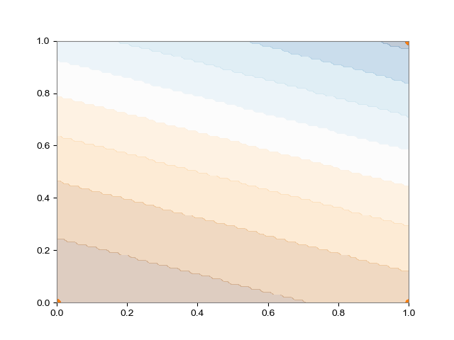
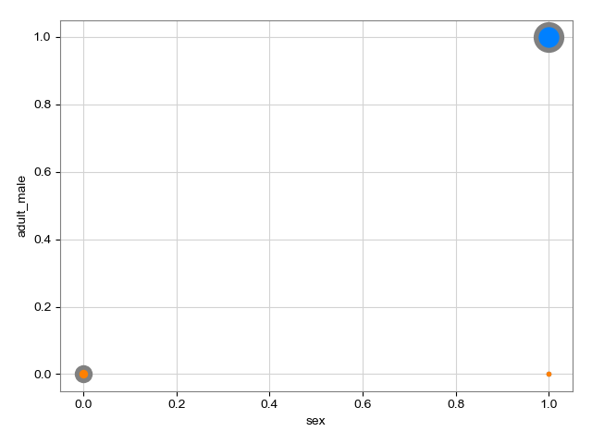
Data charts
Density plot: titanic dataset

Slide 25
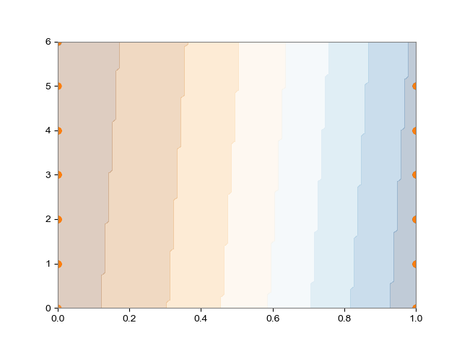
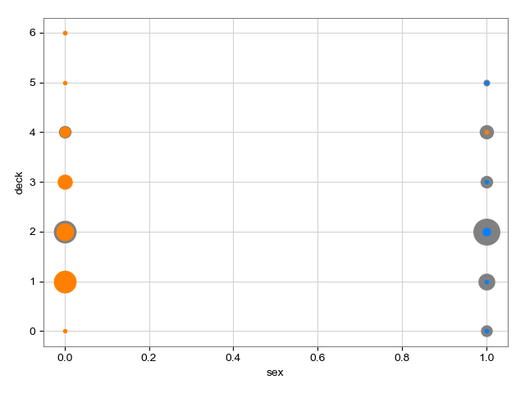
Data charts
Density plot: titanic dataset

Slide 26
Time Series

Slide 27
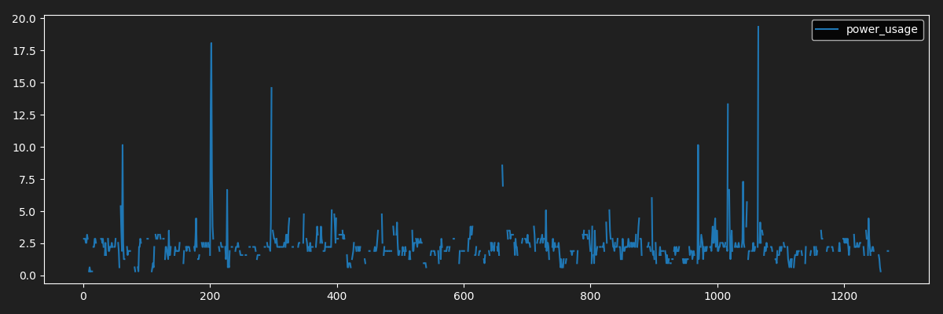
Data charts
Time Series: pandas
fig = plt.figure(figsize=(12, 4)) ax = plt.gca() if darkmode: plt.style.use('dark_background') clr = numpy.array((32, 32, 32)) / 255 fig.patch.set_facecolor(clr) ax.set_facecolor(clr) ax.spines['bottom'].set_color('white') ax.spines['top'].set_color('white') ax.spines['left'].set_color('white') ax.spines['right'].set_color('white') ax.xaxis.label.set_color('white') ax.tick_params(axis='x', colors='white') ax.tick_params(axis='y', colors='white') else: plt.style.use('classic') fig.patch.set_facecolor((1, 1, 1)) X = None if idx_feature is None else df.columns[idx_feature] df.plot(x=X,y=df.columns[idx_target],ax=ax) plt.tight_layout() if filename_out is not None: plt.savefig(filename_out, facecolor=fig.get_facecolor()) plt.close()

Slide 28
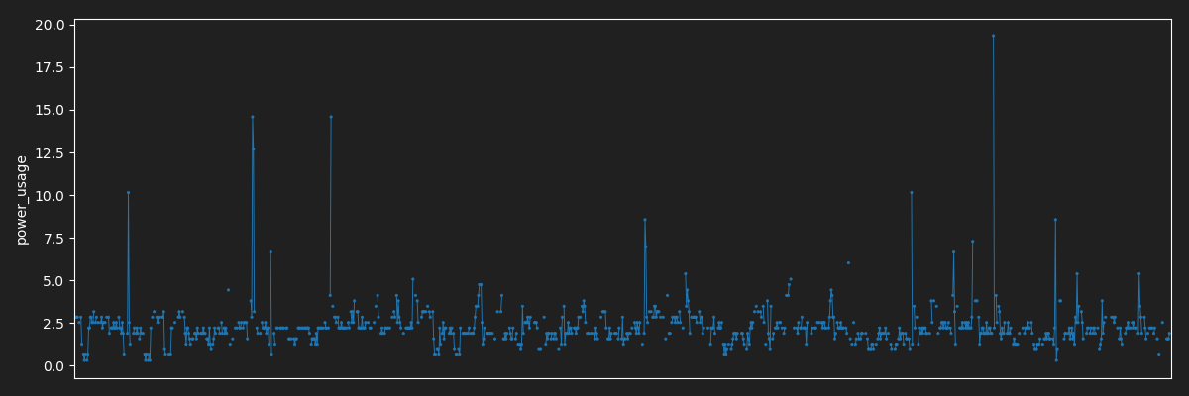
Data charts
Time Series: seaborn
fig = plt.figure(figsize=(12, 4)) pal = numpy.array(['tab10', 'husl', 'Set2', 'Paired', 'hls'])[0] colors = sns.color_palette(palette=pal, n_colors=1) if darkmode: plt.style.use('dark_background') clr = numpy.array((32, 32, 32)) / 255 fig.patch.set_facecolor(clr) plt.gca().set_facecolor(clr) else: plt.style.use('classic') fig.patch.set_facecolor((1, 1, 1)) X = df.index if idx_feature is None else df.columns[idx_feature] markers = 'o' if idx_feature is None: if mode=='pointplot': g = sns.pointplot(data=df, x=X, y=df.columns[idx_target], scale=0.25,markers=markers,color=colors[0]) g.set(xticks=[]) else: g = sns.lineplot(data=df, x=X, y=df.columns[idx_target],color=colors[0]) plt.tight_layout() if filename_out is not None: plt.savefig(filename_out,facecolor=fig.get_facecolor()) plt.close()

Slide 29

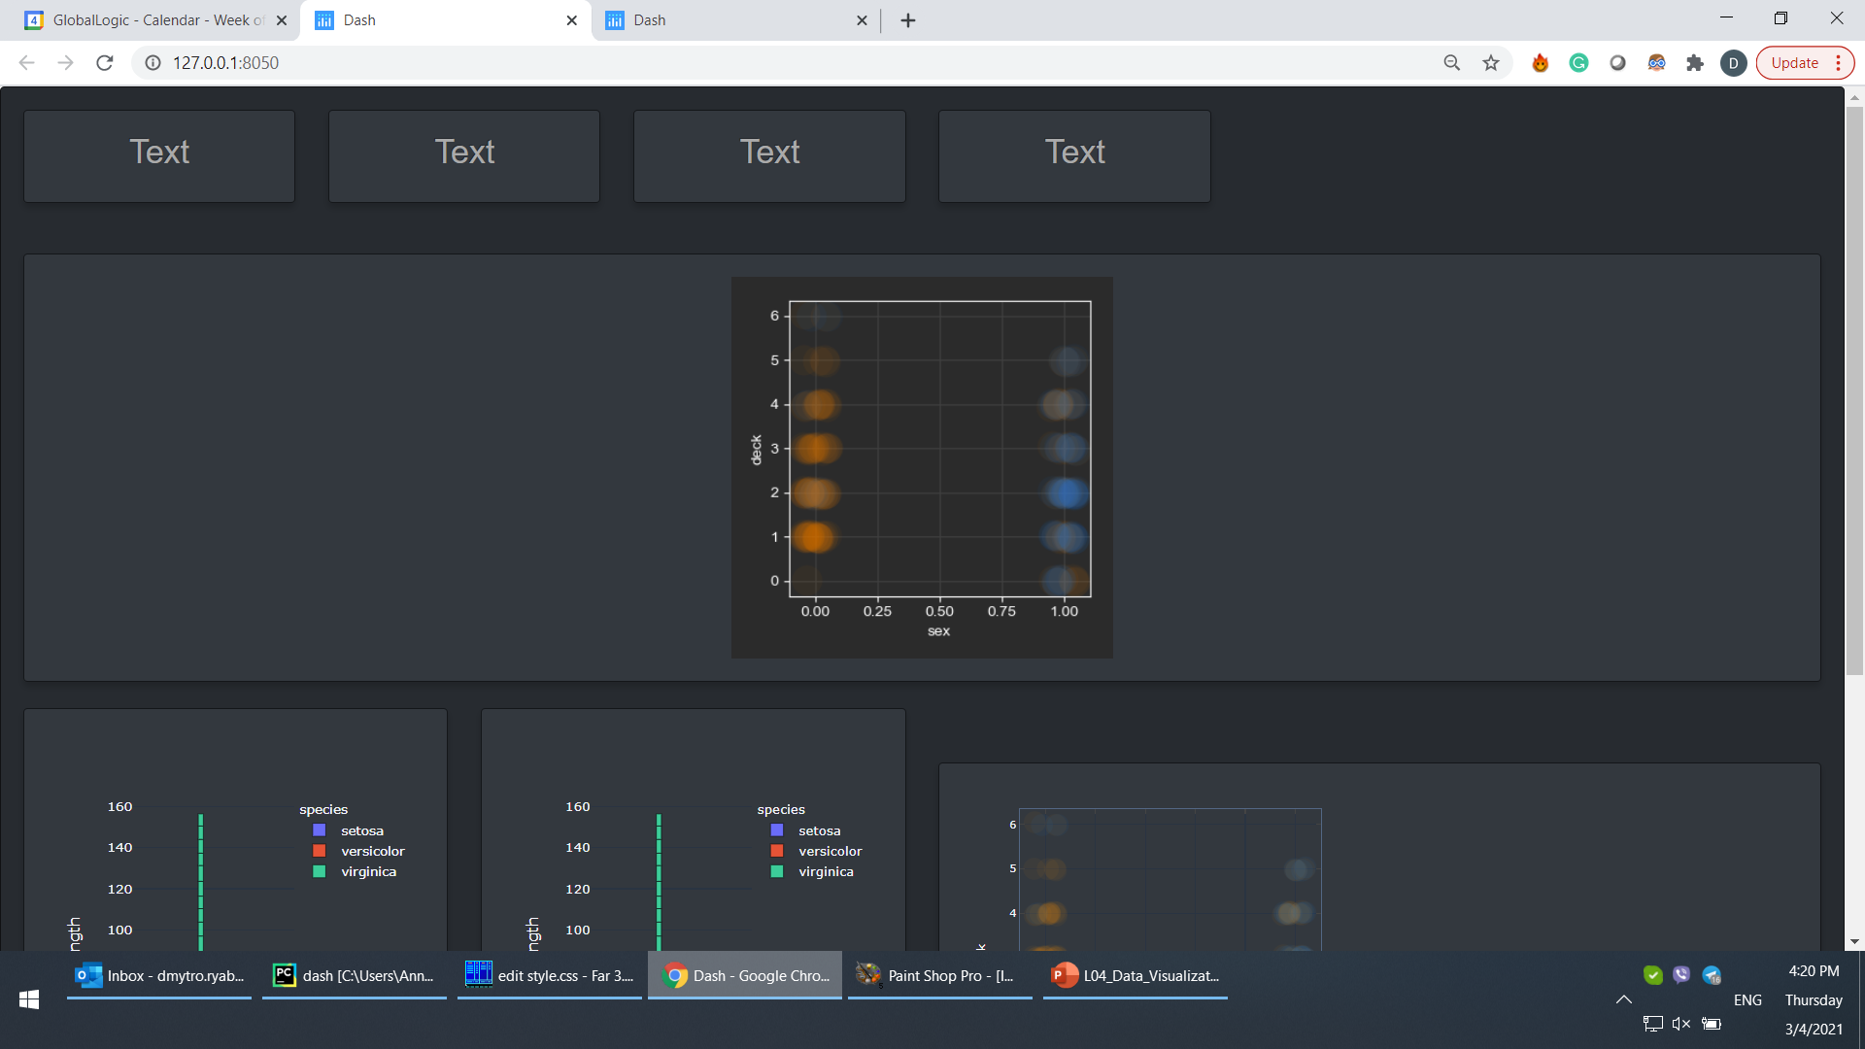
Data Charts
References
https://www.tutorialdocs.com/article/python-matplotlib-tutorial.html

